Slide 1


Slide 2
Machine learning
Introduction

Slide 3



What is machine learning
Model
Data
Learn a Task
Don’t tell me if-then rules, Just give me the data and I will learn the task

Slide 4
Types of machine learning: (1) Supervised Learning
Input
Output
Input and output are known
The model learns the relationship between input and output

Slide 5
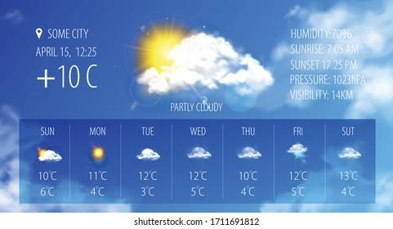
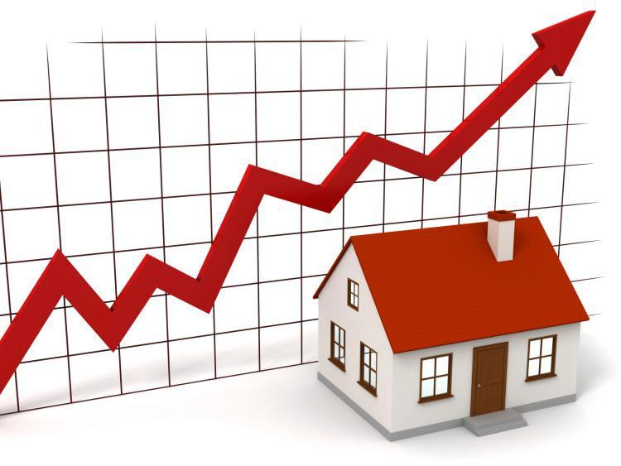

Supervised Learning Examples:
Regression
Predicting Stock Market Changes
Predicting temperature
Predicting House Prices

Slide 6
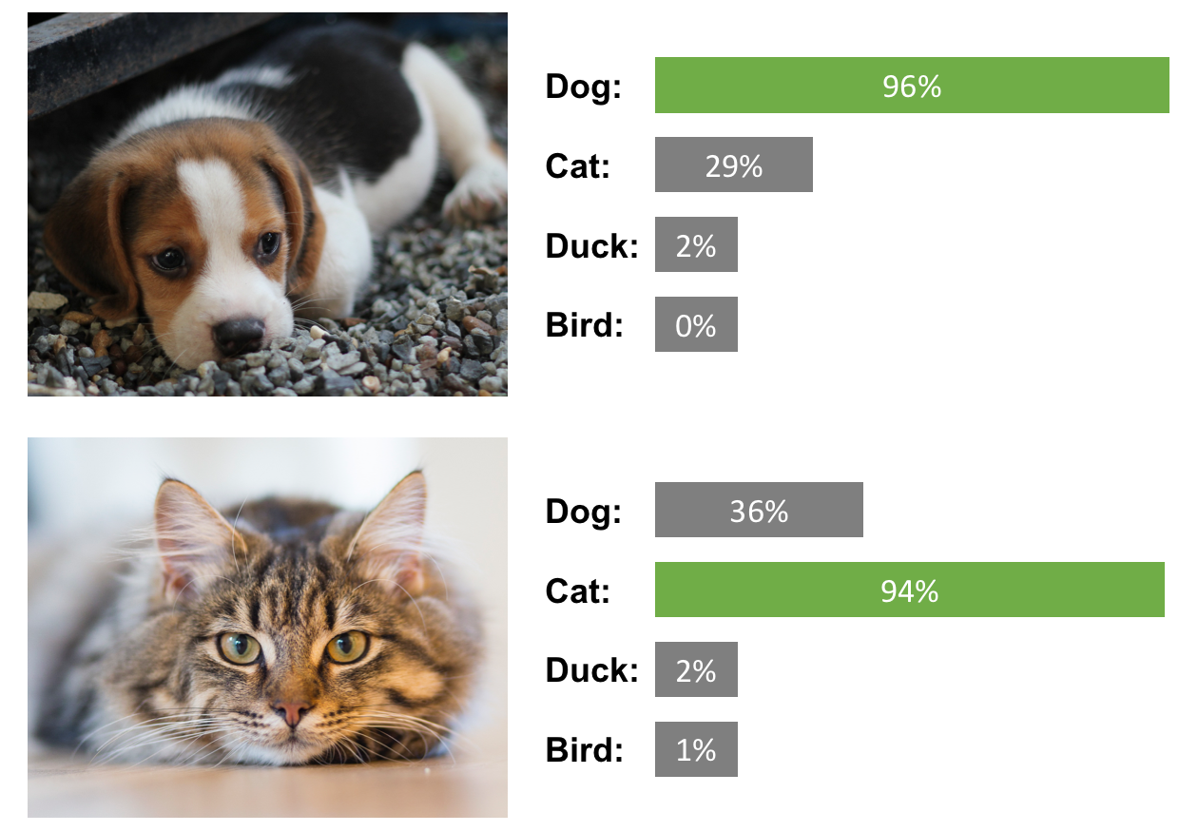


Supervised Learning Examples:
Classification
Medical diagnosis (disease classification)
Email classification (Spam/not spam)
Image classification

Slide 7
Types of machine learning: (2) Unsupervised Learning
Input
Output
Only Input is known
The model performs a task with the input such as:
Grouping similar objects together (Clustering)

Slide 8
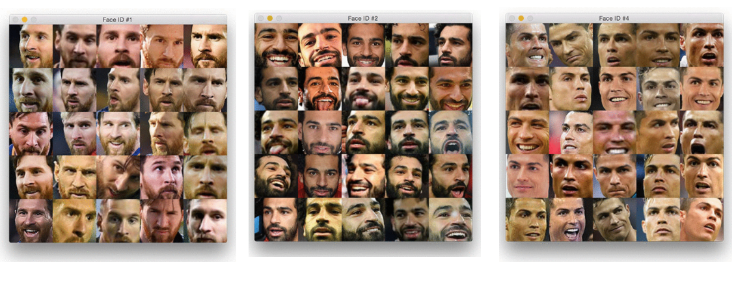
Unsupervised Learning Examples:
Clustering
Grouping similar images together

Slide 9



Types of machine learning: (3) Reinforcement Learning
simulation
Inside a simulation: An agent learns a task by interacting with the environment using trial and error

Slide 10
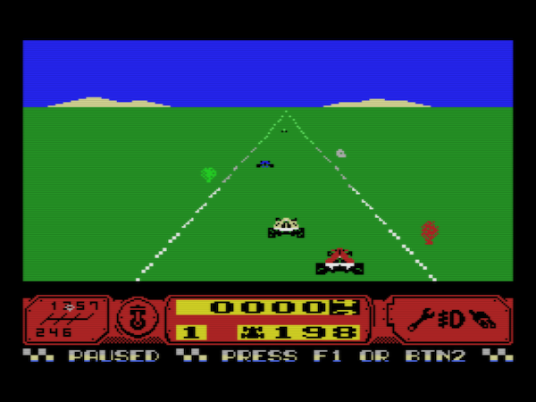
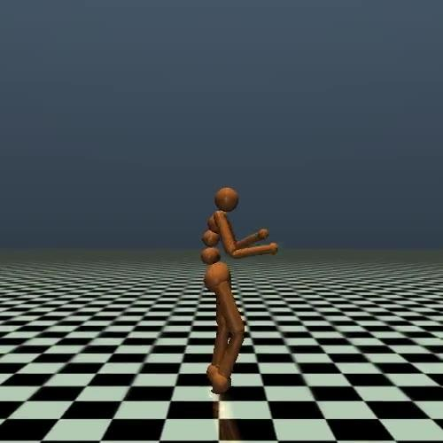
Reinforcement Learning Examples:
Learning to play a game
Learning how to walk

Slide 11
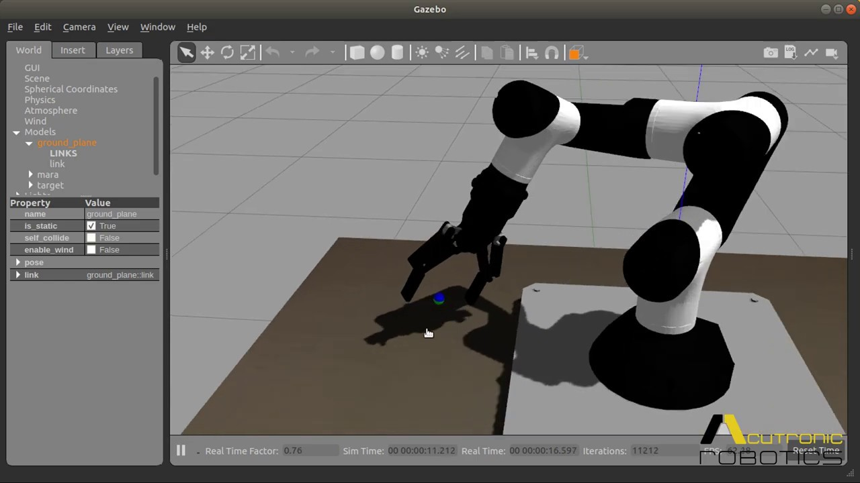

Reinforcement Learning Examples:
Learning to control a robotic arm
Autonomous drone

Slide 12
Dataset (Structured data)
Inputs (features/attributes)
desired output (target)
house age | distance to nearest MRT Station | Convenience Stores | price per unit area
32 | 84.88 | 10 | 37.9
19.5 | 306.59 | 9 | 42.2
13.3 | 561.98 | 5 | 47.3
5 | 390.57 | 5 | 54.8
7.1 | 2175.03 | 3 | 32.1
Each row is called sample,
or instance,
or pattern
Examples of structured data: Excel files or SQL databases

Slide 13




Unstructured data

Slide 14
Machine Learning Models (examples)
Linear/Non-linear regression
Logistic regression
Naïve Bayes Classifier
K Nearest Neighbors
Decision Tree
Random Forest
Support Vector Machine
Ensemble Models
Neural Network

Slide 15
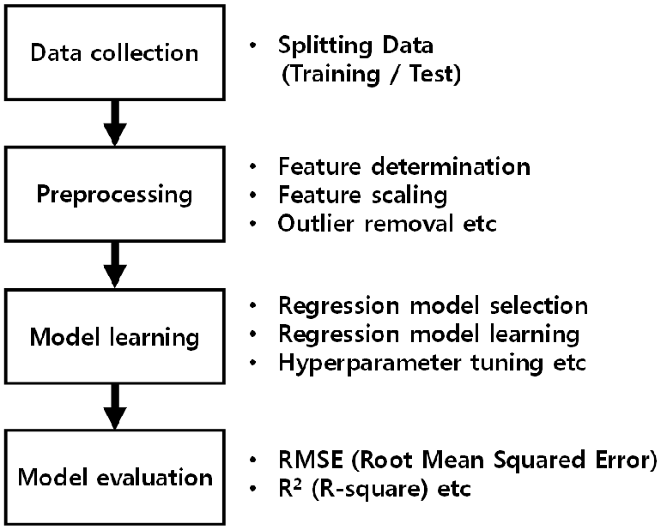
Steps Of Machine Learning

Slide 16





Machine learning engineering
Understanding objective
Building machine learning model
Model deployment
Model testing

Slide 17
Getting dataset

Slide 18
We can download free data from
UCI Machine Learning Repository: https://archive.ics.uci.edu/ml/datasets.php
Kaggle datasets: https://www.kaggle.com/datasets
Google dataset search: https://datasetsearch.research.google.com/

Slide 19
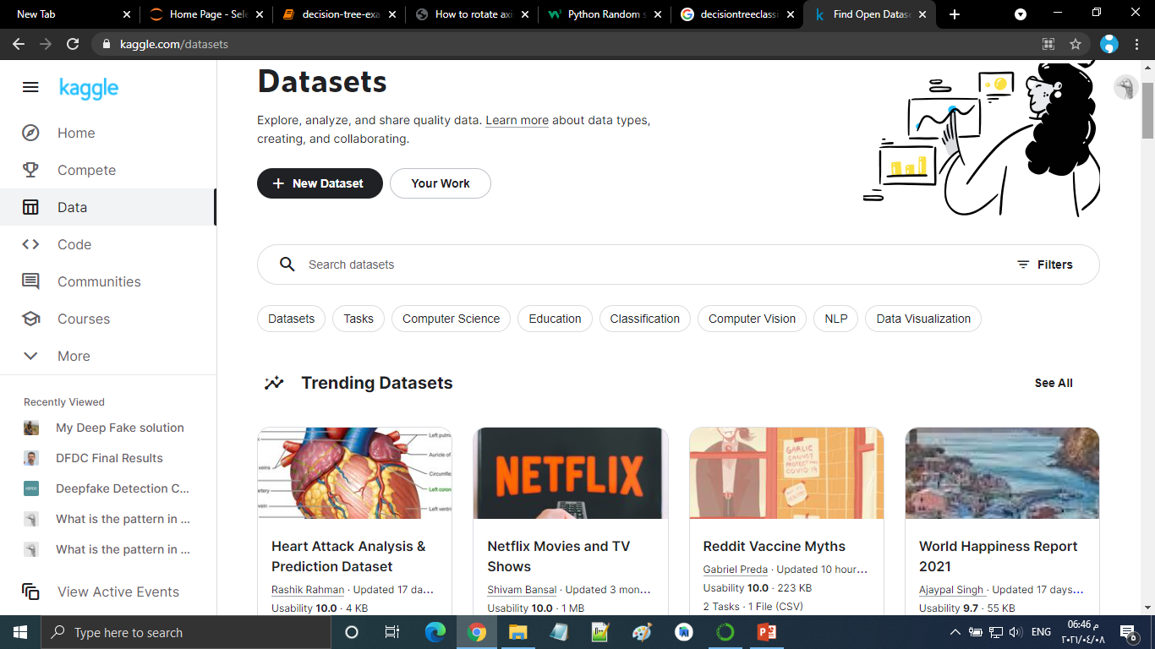
Kaggle datasets

Slide 20


Slide 21
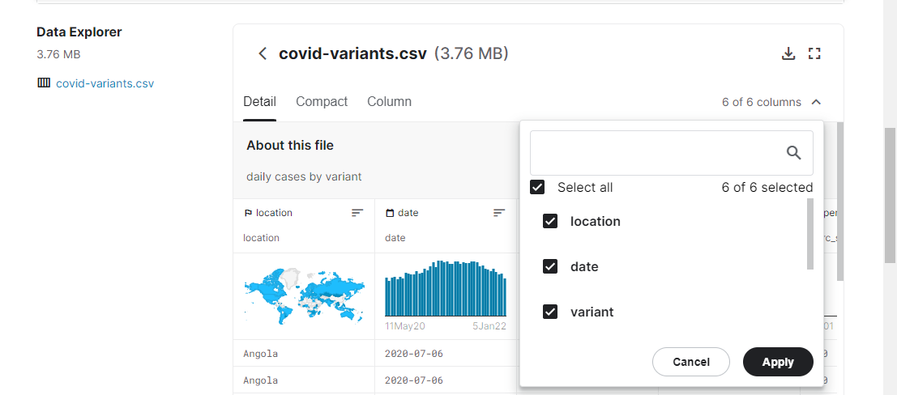

Slide 23
Data preprocessing
Converting the raw data to a format that can easily be processed by our model
Raw data
Data cleaning
Data encoding
Preprocessed data
Feature selection/ dimensionality reduction
Data normalization

Slide 24
(1) Data cleaning
x1 | x2 | x3 | Target
1 | 2 | 3 | 1
? | 1 | 4 | 0
2 | 5 | 3 | 1
1 | ? | 2 | 1
2 | ? | 1 | 0
3 | 1 | 0 | 1
8 | 2 | 7 | 0
Removing undesired data (such as rows with missing values)
Another way to handle missing values is to replace them by column mean

Slide 25
(2) Data encoding
country | gender | x3 | Target
Egypt | Male | 3 | Negative
US | Female | 4 | Positive
Germany | Male | 3 | Positive
UK | Female | 2 | Negative
US | Female | 1 | Positive
Egypt | Male | 0 | Negative
France | Male | 7 | Negative
Most of machine learning models require numerical input and output
Features with categorical values (nominal values) must be converted to (encoded as) numerical features.
Target must also be converted to numerical value

Slide 26
(2) Data encoding
country | gender | x3 | Target
Egypt | 0 | 3 | 0
US | 1 | 4 | 1
Germany | 0 | 3 | 1
UK | 1 | 2 | 0
US | 1 | 1 | 1
Egypt | 0 | 0 | 0
France | 0 | 7 | 0
For binary features/outputs we can use 0 and 1
For gender: 0 for male, 1 for female
For target: 0 for negative, 1 for positive

Slide 27
(2) Data encoding
country | gender | x3 | Target
0 | 0 | 3 | 0
1 | 1 | 4 | 1
2 | 0 | 3 | 1
3 | 1 | 2 | 0
1 | 1 | 1 | 1
0 | 0 | 0 | 0
4 | 0 | 7 | 0
For features with more than 2 values, we can encode each value using a number
Example: For country:
0 = Egypt
1 = US
2 = Germany
3 = UK
4 = France

Slide 28
(2) Data encoding
Or we can use one-hot encoding
Country-Egypt | Country-US | Country-Germany | Country-UK | Country-France | Gender | x3 | Target
1 | 0 | 0 | 0 | 0 | 0 | 3 | 0
0 | 1 | 0 | 0 | 0 | 1 | 4 | 1
0 | 0 | 1 | 0 | 0 | 0 | 3 | 1
0 | 0 | 0 | 1 | 0 | 1 | 2 | 0
0 | 1 | 0 | 0 | 0 | 1 | 1 | 1
1 | 0 | 0 | 0 | 0 | 0 | 0 | 0
0 | 0 | 0 | 0 | 1 | 0 | 7 | 0

Slide 29

(3) Data normalization
Min = 0 |  | Max = 1000000
If features have very different ranges
Example: if x1 has range 0-10 while x2 has range 0-1000000
We should normalize the features (make them have the same range)
For example: The following formula will make any feature have the range 0-1
Normalization
Min = 0 |  | Max = 1
$$X_{new}=\frac{X_{old}−X_{min}}{X_{max}−X_{min}}$$

Slide 30
(4) Feature selection / dimensionality reduction
x1 | x2 | x3 | x4 | x5
If you have a large number of features, you can reduce their number using either:
Feature selection: Selecting the most important features and dropping the less important ones
Dimensionality reduction: Calculating new features from the original ones such that the number of new features is small.
Feature Selection
x1 | x2 | x3 | x4 | x5
x1 | x2 | x3 | x4 | x5
Dimensionality Reduction
z1 | z2 | z3

Slide 31
Preprocessed data
After preprocessing, we can easily use the preprocessed data to train our model
Raw data
Data cleaning
Data encoding
Preprocessed data
Feature selection/ dimensionality reduction
Data normalization

Slide 32
Evaluation Metrics
Regression

Slide 33
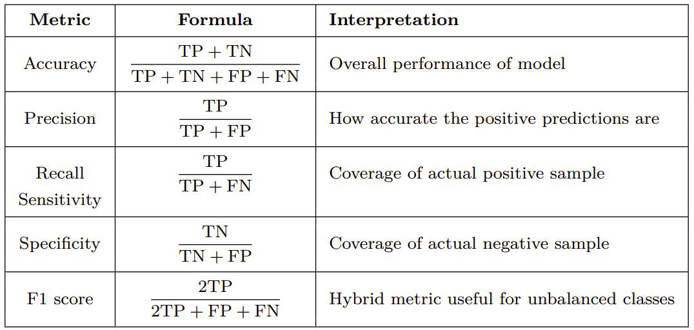
Evaluation Metrics
Classification
Confusion Matrix

Slide 34
Overfitting And Underfitting

